Slide 1


Green Pace
Security Policy Presentation
Developer: Chris Stevens
Notes:
https://youtu.be/1_VBzmgSmLM

Slide 2

OVERVIEW: DEFENSE IN DEPTH
No single security control can protect an organization from every threat, which is why defense in depth relies on multiple overlapping layers of protection. This policy defines one of those critical layers, ensuring that a failure in any single control does not lead to a total compromise. Without formal policies in place, gaps between technical defenses create opportunities for attackers to succeed.
Notes:
This image illustrates a Defense-in-Depth security model, where multiple layers of protection surround critical assets and data.
At the center are the organization’s critical systems and sensitive data — the primary assets we are trying to protect.
Surrounding them are layered security controls, including application security, endpoint security, host security, network security, and perimeter security. Each layer provides its own protections such as vulnerability scanning, encryption, patch management, intrusion detection, and access control.
Beyond technical controls, the model also includes governance, policies, security operations, intelligence, compliance, and physical security. This highlights that cybersecurity is not just technical — it includes people, processes, and oversight.
The key takeaway is that no single control is enough. If one layer fails, others remain in place to reduce risk, detect threats, and protect critical assets.

Slide 3
THREATS MATRIX
Likely Low Severity | Likely High Severity
Unlikely Low Severity | Unlikely High Severity
SQL injection
Unhandled exceptions
Hardcoded secrets
String storage space
Access object outside of lifetime
Dynamic resource deallocation
Multiple definitions
Order of evaluation
Constant expression static assertion
Unclosed file resources

Slide 4
10 PRINCIPLES
Validate Input Data
Heed Compiler Warnings
Handle all exceptions
Architect and Design for Security Policies
Never hardcode secrets
Keep It Simple
Obey the one definition rule
Default Deny
Adhere to the Principle of Least Privilege
Sanitize Data Sent to Other Systems
SQL injection
Practice Defense in Depth
Use Effective Quality Assurance Techniques
Adopt a Secure Coding Standard
Don't access object outside of lifetime
Close files when they are no longer needed
Order of evaluation
Constant exp static assertion
String storage space
Dynamic resource deallocation

Slide 5
CODING STANDARDS
Notes:
Coding Standards Priority Summary
Priorities were assigned using a risk-based approach evaluating:
Severity – Impact if violated
Likelihood – Probability of occurrence
Remediation Cost – Effort to fix
Overall Risk Level (1–5) – Combined priority score
High Priority (Level 5)
Examples: SQL Injection prevention, hard-coded secrets
High impact
Likely to occur
Direct data exposure risk → Immediate enforcement required
Medium Priority (Levels 3–4)
Examples: Memory lifetime, resource deallocation, exception handling
Stability and security implications
Moderate likelihood or cost → Strong enforcement recommended
Lower Priority (Levels 1–2)
Examples: Static assertions, file closure
Lower security impact
Less likely or minimal risk → Best practice compliance
Overall Strategy
Priority focuses first on protecting sensitive data and preventing exploitation, then addressing stability and maintainability issues.
Risk reduction drives enforcement order.

Slide 6
ENCRYPTION POLICIES
Encryption at rest
Protects stored data such as databases, backups, file systems, and cloud storage. Use strong standards (e.g., AES-256) and securely manage encryption keys separately from the data.
Encryption in flight
Protects data moving across networks. Use secure protocols such as TLS, HTTPS, SSH, or VPNs to prevent interception or tampering.
Encryption in use
Protects sensitive data while it is being processed in memory. Limit plaintext exposure and restrict access to authorized processes; leverage OS or hardware protections where possible.
Notes:
Encryption at rest
Any sensitive or confidential data at rest, such as databases, file systems, backups, cloud storage, removable media, etc. must be encrypted. Best practice encryption, for example AES-256. Encryption keys must be protected and cannot be stored as plain text alongside the data. Encrypting stored data in this manner protects unauthorized access in the event of a system compromise, storage theft or improper disposal of media.
Encryption in flight
All data shall be encrypted in-transit across networks. Standard protocols like TLS, HTTPS, SSH or VPNs. Encryption in transit protects against interception, eavesdropping and tampering by ensuring that captured network cannot be read or modified by unauthorized individuals.
Encryption in use
Sensitive data must be protected while being processed by applications. Plain text exposure in memory must be minimized and access to data during processing must be restricted to only authorized components. Where possible, OS or hardware-based protections should be used. The purpose of encryption in use is to reduce risk from memory scraping, debugging tools, etc.

Slide 7
TRIPLE-A POLICIES
Authentication
Determines what resources and actions a verified user is allowed to access. Access is controlled through roles, permissions, and user attributes.
Authorization
Determines what resources and actions a verified user is allowed to access. Access is controlled through roles, permissions, and user attributes.
Accounting
Tracks user activity and resource usage. Provides logging for auditing, compliance, monitoring, and capacity planning.
Notes:
Authentication
Authentication is the first step in the AAA process where the network or application identifies a user and ensures the user is who they claim to be. This is required so that when a user logs in, we can ensure verify who they are. This can done be through passwords, single sign-on systems, biometrics, certificates or keys.
Authorization
Authorization is what defines the resources a user has access to and what functions they are allowed to execute. User attributes are required so that user access can be controlled. These attributes can allow functions such as allowing the user to make changes to a database or admin functions like adding new users.
Accounting
Accounting tracks resources that have been accessed and what actions a user has performed and at what time. This usage information will be used to ensure authorization control, billing calculations, trend analysis and capacity analysis/planning.

Slide 8
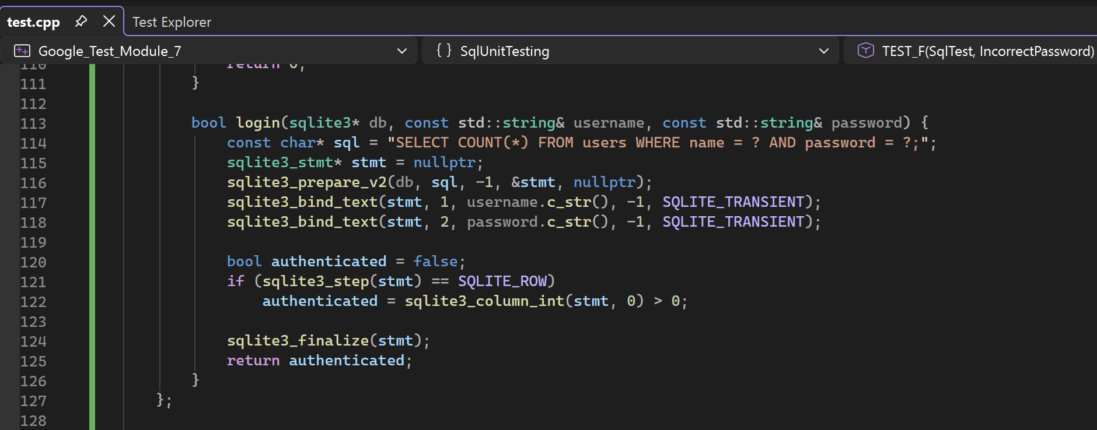
SQL Unit Testing
SQL Injection
Proper handling of SQL commands is critical for application security. Without consideration, an attacker can potentially bypass login verification, fetch unauthorized information or drop entire tables. Establishing unit tests for methods that interact with a SQL table can verify that vulnerabilities do not currently exist and ensure that changes committed to the codebase later are checked to ensure an update hasn’t impacted security.

Slide 9
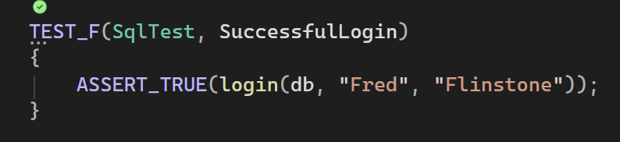
SQL Unit Testing
Successful Login Test

Slide 10
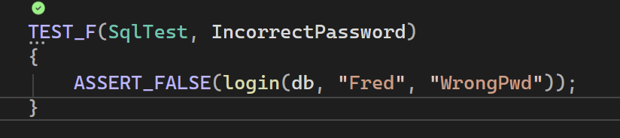
SQL Unit Testing
Unsuccessful Login Test

Slide 11
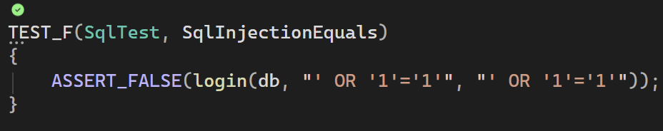
SQL Unit Testing
SQL Login Bypass Injection Test

Slide 12
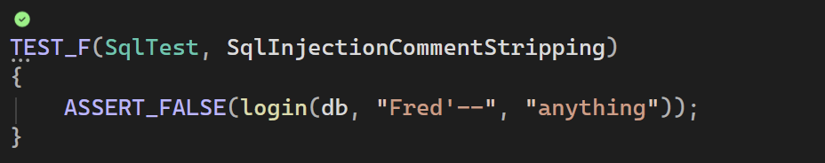
SQL Unit Testing
SQL Login Bypass Injection Test

Slide 13
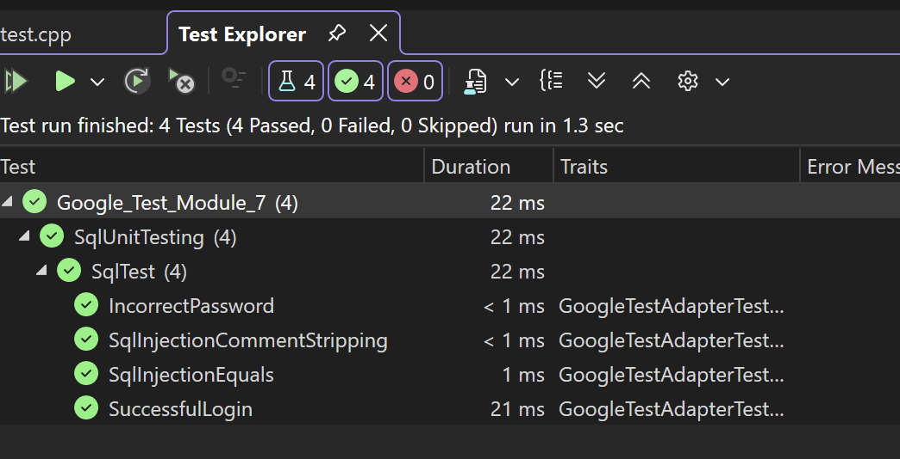
SQL Unit Testing
Test Results

Slide 14

AUTOMATION SUMMARY
Notes:
This image illustrates a continuous DevSecOps security lifecycle, showing that security must be embedded across both development and production environments.
In pre-production, security starts with assessing risks and planning. It continues through secure design, secure coding practices, and thorough testing — including vulnerability and compliance checks — before anything reaches production.
In production, the focus shifts to secure deployment, continuous monitoring, threat detection, and rapid incident response. If an attack occurs, systems are stabilized and restored to a secure baseline.
The key takeaway is that security is not a one-time step — it is a continuous loop. Development, Security, and Operations must work together to proactively reduce risk and respond effectively to evolving threats.

Slide 15
TOOLS
With Green Pace’s established CI/CD processes, a revision control repository is in use. As code is committed to a feature branch, we will run automated tests as part of the pipeline. This allows the team to ensure standard tests are ran and enforce rules before a commit’s pull request can be approved for merge to the production code base. Essentially, Build/Verify/Test happen as each bit of code change is committed to a feature branch. This allows the team to quickly catch issues and address them as the build is happening.

Slide 16
RISKS AND BENEFITS
Today’s tech landscape is built upon many different services and packages that work together. Platform SDKs and APIs allow for easy integration like never before. While this has been a game changer for how quickly tailored solutions can be provided to customers, it’s also greatly increased the attack surface for companies. Generative AI has introduced a new tool for hackers to leverage vulnerabilities. Not implementing a security policy puts the company at great risk of becoming one of the 45% of companies facing attacks (Fortinet, 2022).
Why should we act now?
Regulatory compliance
Customer trust
Faster incident response
Lower long-term remediation costs
Competitive advantage

Slide 17
RECOMMENDATIONS
Establish governance
Define security ownership
Implement formal security policy
Implement AAA
Authentication
Authorization
Accounting
Enforce defense in depth
Strengthen DevSecOps
Code scanning
Dependency scanning
CI/CD Review processes
Continued risk assessment

Slide 18
CONCLUSIONS
To prevent future attacks and reduce risk, the company should adopt recognized industry standards rather than fragmented controls.
NIST Cyber Security Framework
Identify, Protect, Detect, Respond and Recover (Top 9 Cybersecurity Frameworks in 2024, 2024)
NIST Software Security Development Framework
A structured approach to secure software development, reducing vulnerabilities and enhancing resilience. (Montauban, 2025)
ISO 27001 and 27002
The industry standard for information security management (Top 9 Cybersecurity Frameworks in 2024, 2024)

Slide 19
REFERENCES
Fortinet. (2022). Top Cybersecurity Statistics, Facts, and Figures for 2021. Fortinet. https://www.fortinet.com/resources/cyberglossary/cybersecurity-statistics
‌ Top 9 Cybersecurity Frameworks in 2024. (2024). Blinkops.com. https://www.blinkops.com/blog/top-cybersecurity-frameworks
Montauban, N. (2025, January 27). What is NIST SSDF and how should you implement it? Codific. https://codific.com/what-is-nist-ssdf-and-how-should-you-implement-it/

